Slide 1
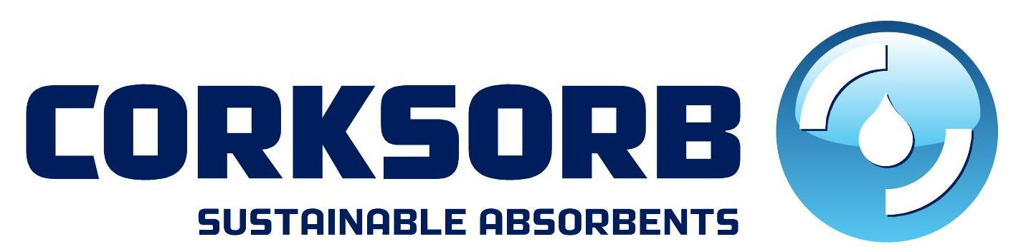
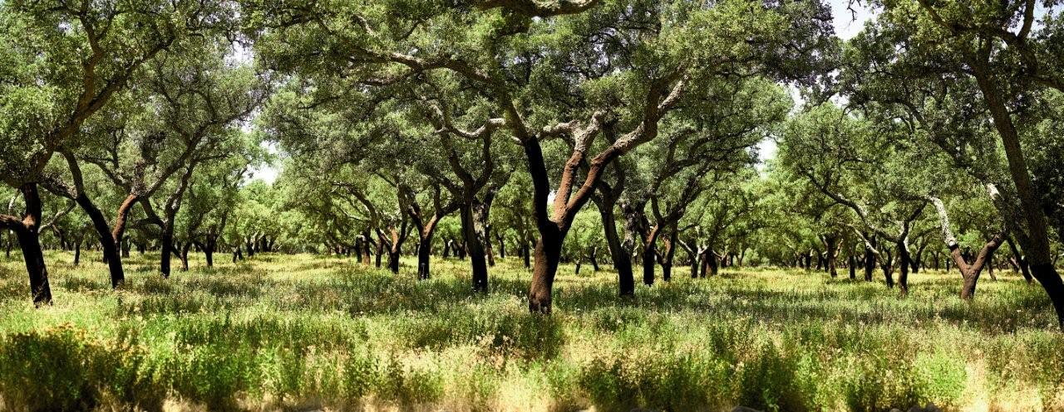
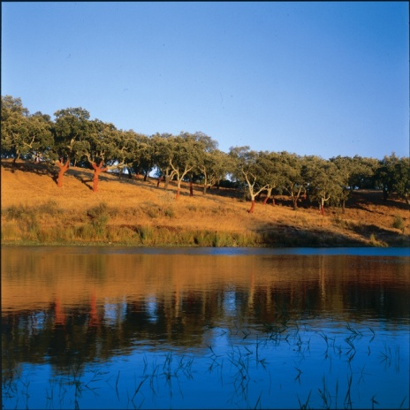
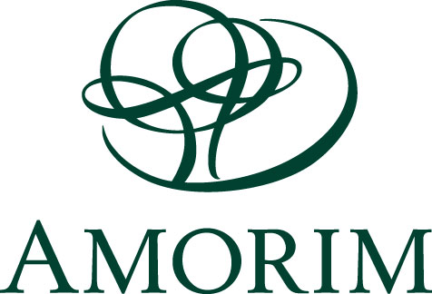

Slide 2
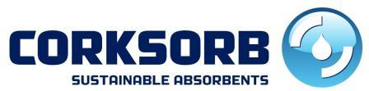
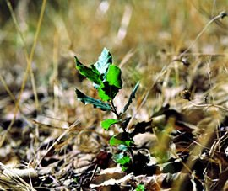
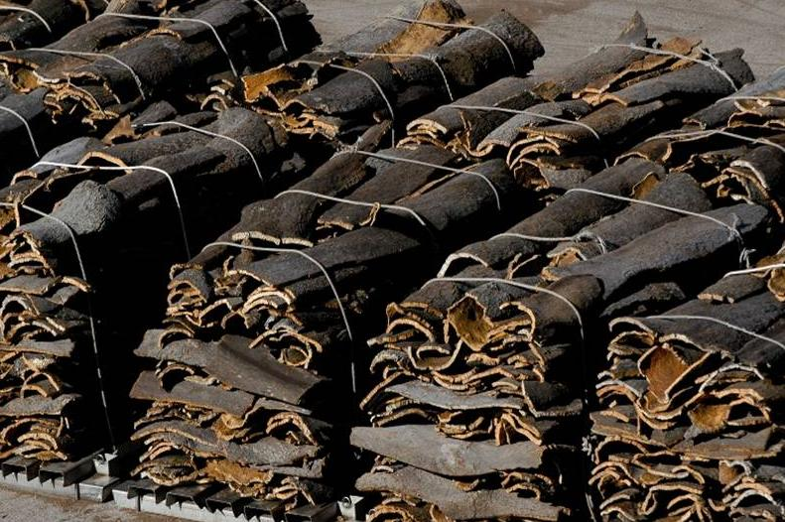
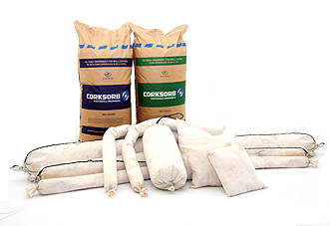
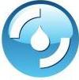
Summary:
  The Company
  Corticeiras’ Amorim Group
  Amorim Environmental Systems
  Raw-Material
  Cork and Sustainability
  Cork as absorbent
  Solutions
  CorkSorb range
  Specifications
  Comparising with other products
  Market
www.corksorb.com

Slide 3
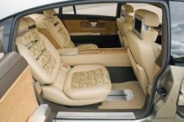

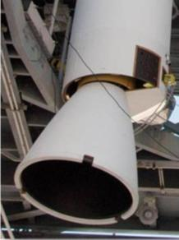
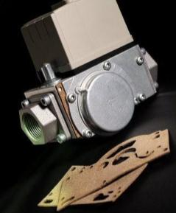
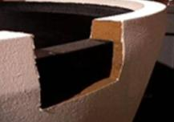
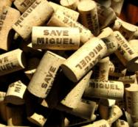
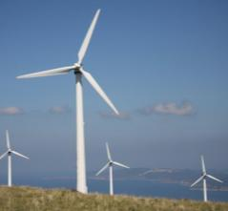

Corticeiras’ Amorim group:
  Some indicators:
    30% market share
    415 M€ turnover in 2009
    140 years leading in cork industry
    3.200 employees
    75 companies
    28 production units
    169 agents
    88.445 tons of cork purchased in 2009
    3.000.000.000 of cork stoppers produced annually
    1st cork company publishing a Sustainability report
    17 new applications for patents were submitted in 2007/09
    5 M€ annual investment in R&D
www.corksorb.com

Slide 4
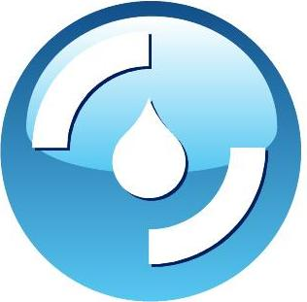
Amorim Environmental Systems:
  Mission: to develop solutions for pollution control based on cork.
  The concept of using a natural product in the fight for environmental protection is fully aligned with Corticeira Amorim’s sustainability policy and company values.
www.corksorb.com

Slide 5
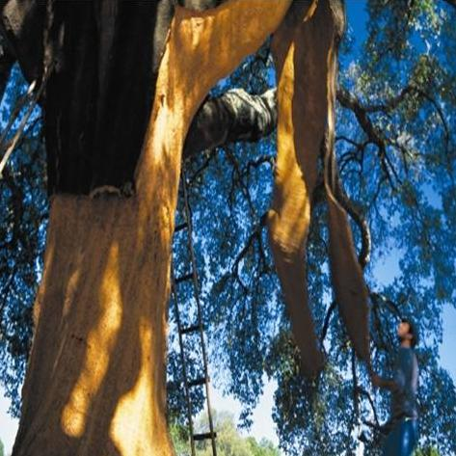
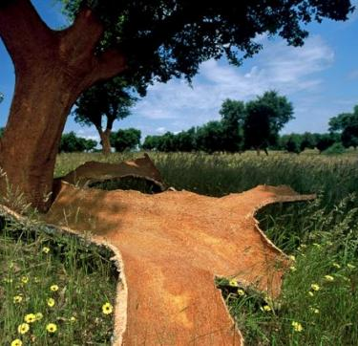
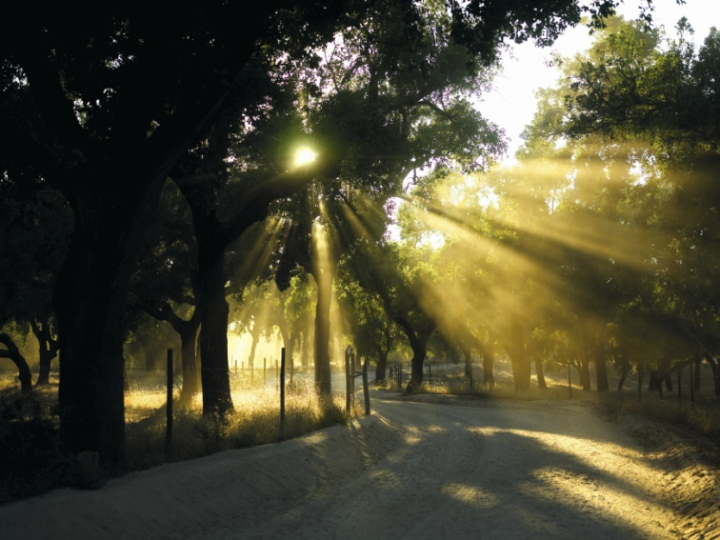
Cork and Sustainability:
  The Cork is extracted without harming the cork oak.
www.corksorb.com

Slide 6
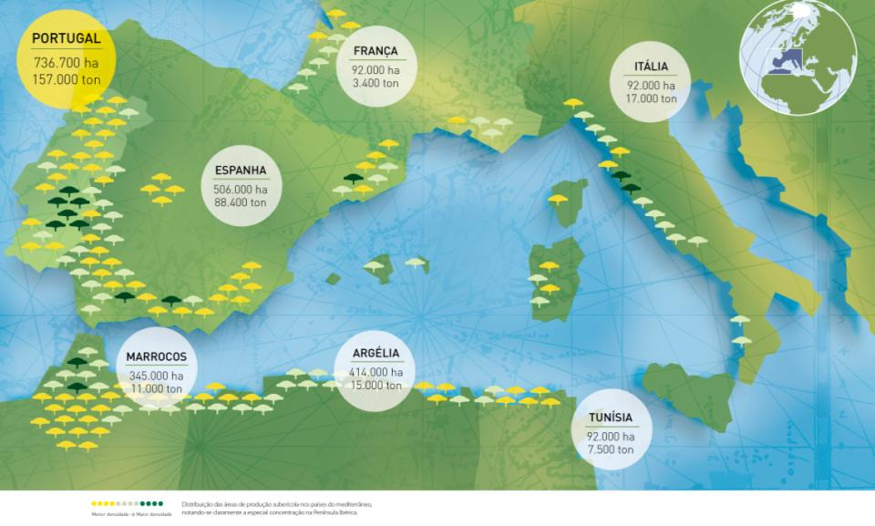
Cork and Sustainability:
  The cork oak (Quercus Suber L.) is a slow growing tree that may live for 200 years, which allows it, on average, to be stripped 16 times during its lifetime.
  Regular extraction of the cork is a fundamental contribution for environmental, economic and social sustainability of the rural areas of the Mediterranean region where the cork oak may be found.
www.corksorb.com

Slide 7
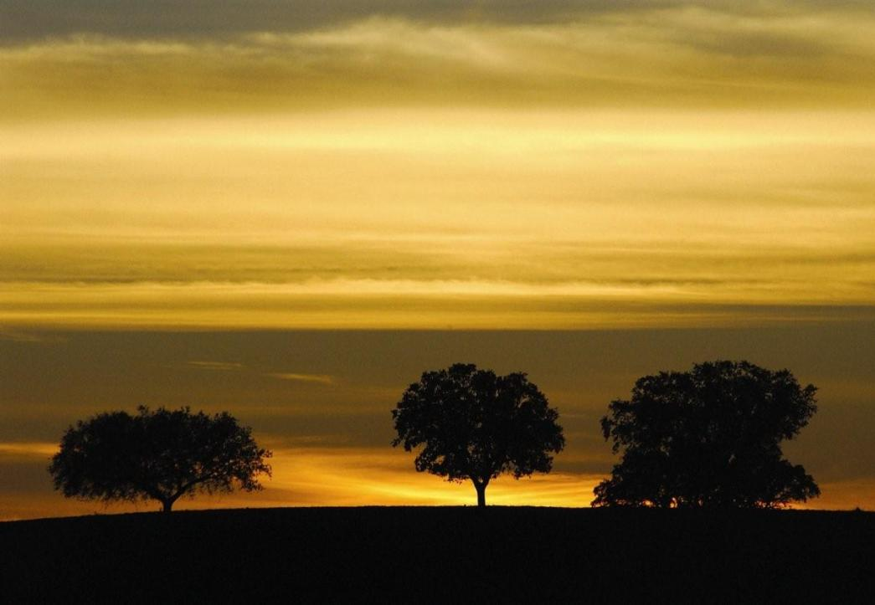
Cork and Sustainability:
  Global Warming:
    Carbon sink: in 2006 the Portuguese cork oak forest represented a carbon sink of around 4.8 million tons of CO2 (5% of total CO2 emissions in Portugal)
    Fires: Thanks to its unique characteristics, cork acts as a natural barrier to fire, actively protecting the cork oak. After extraction of any cork damaged by fire, the cork forest begins a new cycle of cork production.
www.corksorb.com

Slide 8
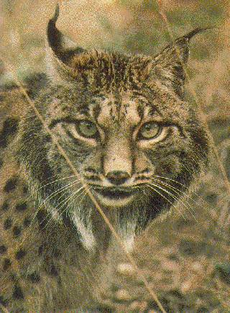
Cork and Sustainability:
  Biodiversity
    The cork oak forest is the basis of an ecosystem unique in the world, contributing to the survival of many native species of fauna and flora
    The cork oak forest is the basis of na ecosystem classified by the Conservation International as one of the thirty four “biodiversity hotspots” of the world(www.biodiversityhotspots.org).
www.corksorb.com

Slide 9
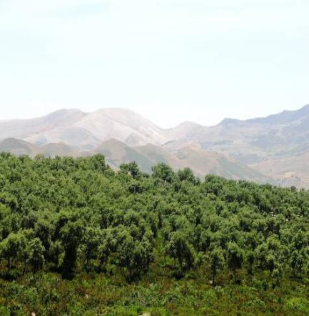
Cork and Sustainability:
Fighting Social & Environmental Desertification
    The cork oak forest plays a fundamental role in combating desertification insofar as it contributes to fixing soil and organic material, reducing erosion and increasing water retention.
    It allows for the creation and maintenance of a significant volume of employment in zones that are especially deprived. Approximately 100 000 people depend on cork. (WWF Report)
Cork oak forest in Aïn Draham, Tunisia, June 2005
www.corksorb.com

Slide 10
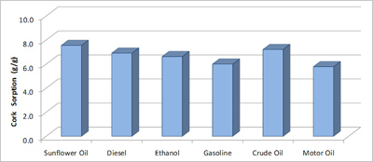
Cork as an absorbent:
    Cork absorbs oils, solvents, hydrocarbons and fats without absorbing water.
    The absorption capacity of CorkSorb was evaluated for different oils and solvents using a test based on the National Standard of Canada number CAN/CGSB-183.2-94.
www.corksorb.com

Slide 11
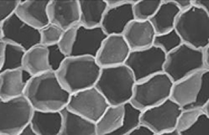
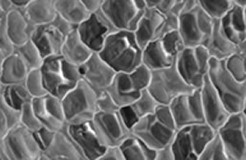
Cork as an absorbent:
    Images of Electronic microscope of cork cells before the absorbing process (left) and after absorbing oil(right)
www.corksorb.com

Slide 12
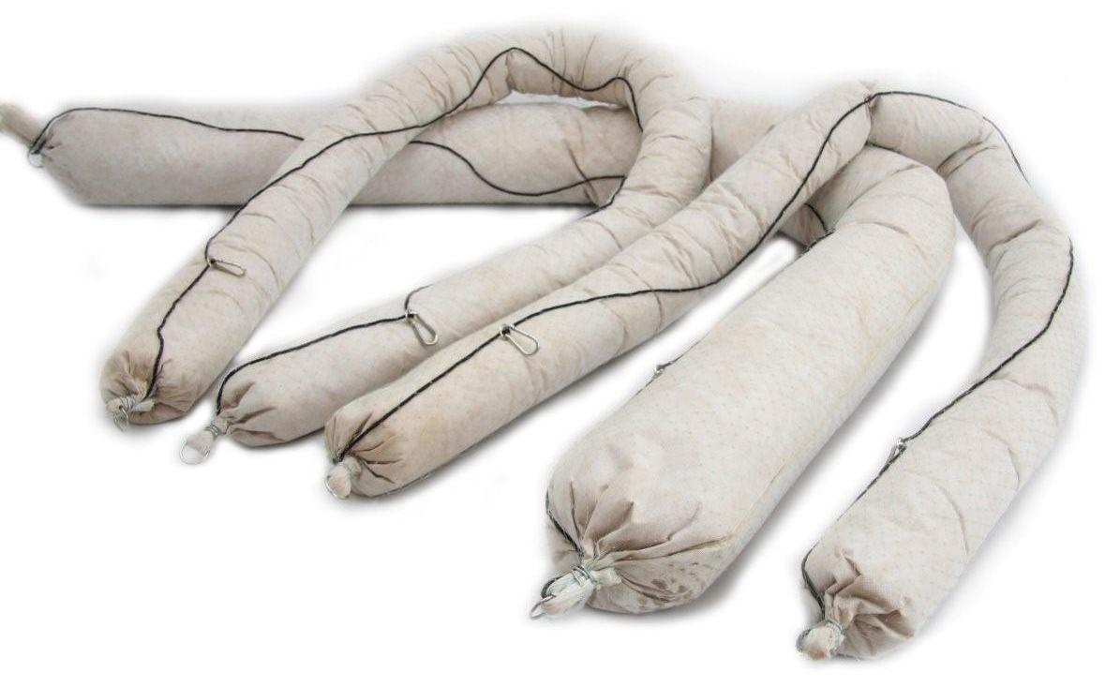
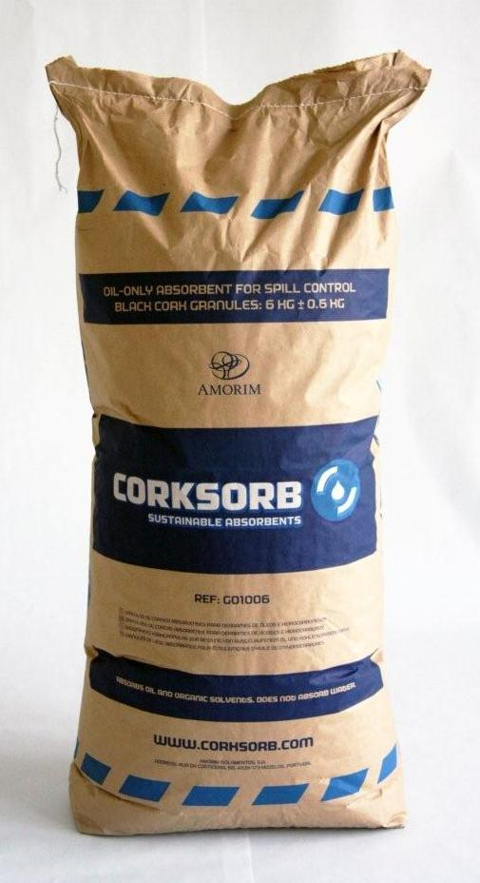
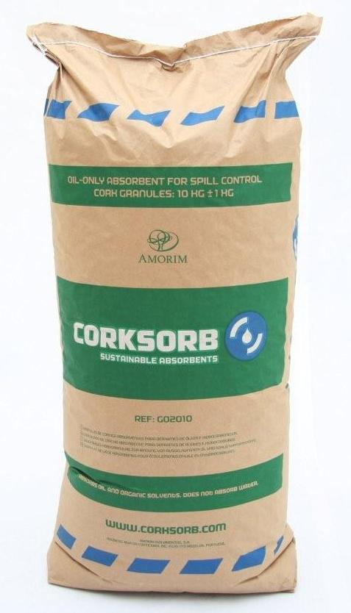
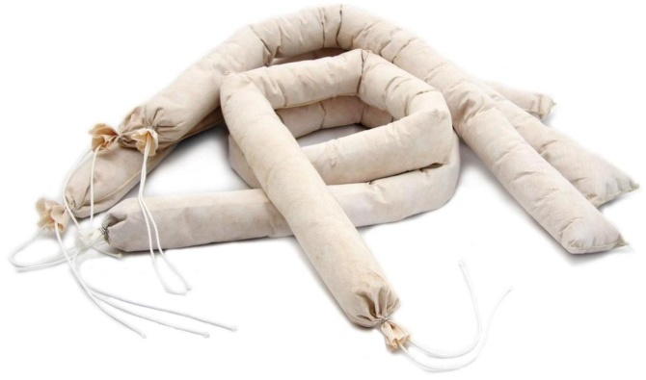
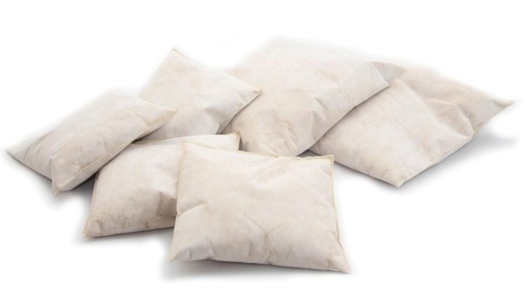
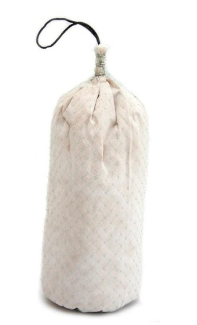
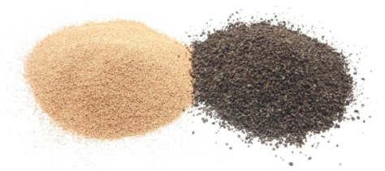
CorkSorb range:
www.corksorb.com

Slide 13
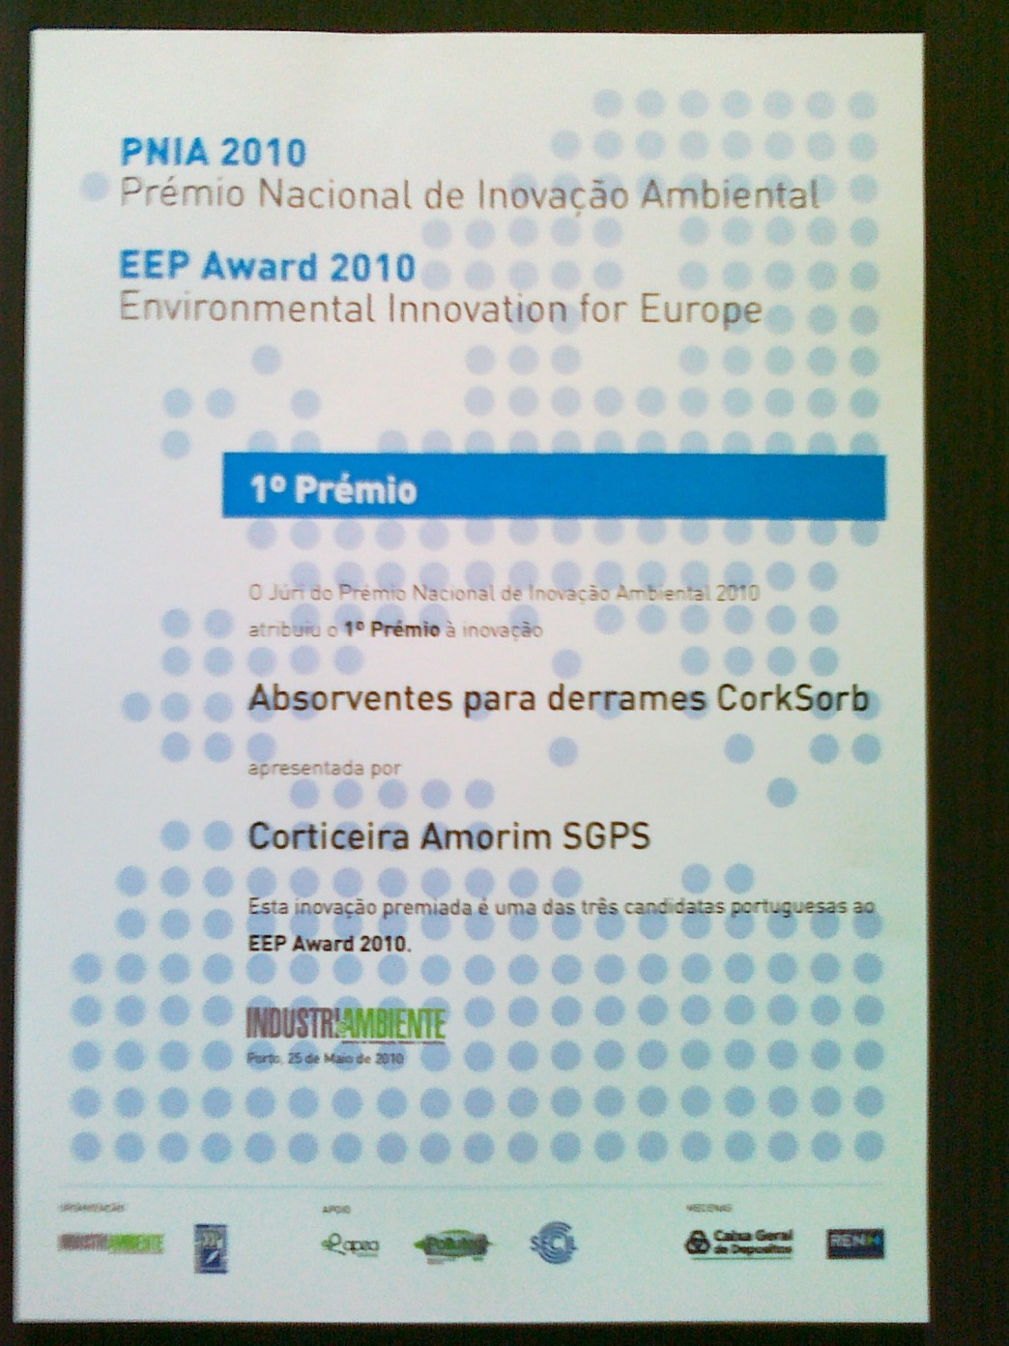
www.corksorb.com

